Slide 1



Relatório 2
View in Power BI
Last data refresh:
11/02/2024 20:26:30 UTC
Downloaded at:
12/02/2024 07:09:37 UTC

Slide 2
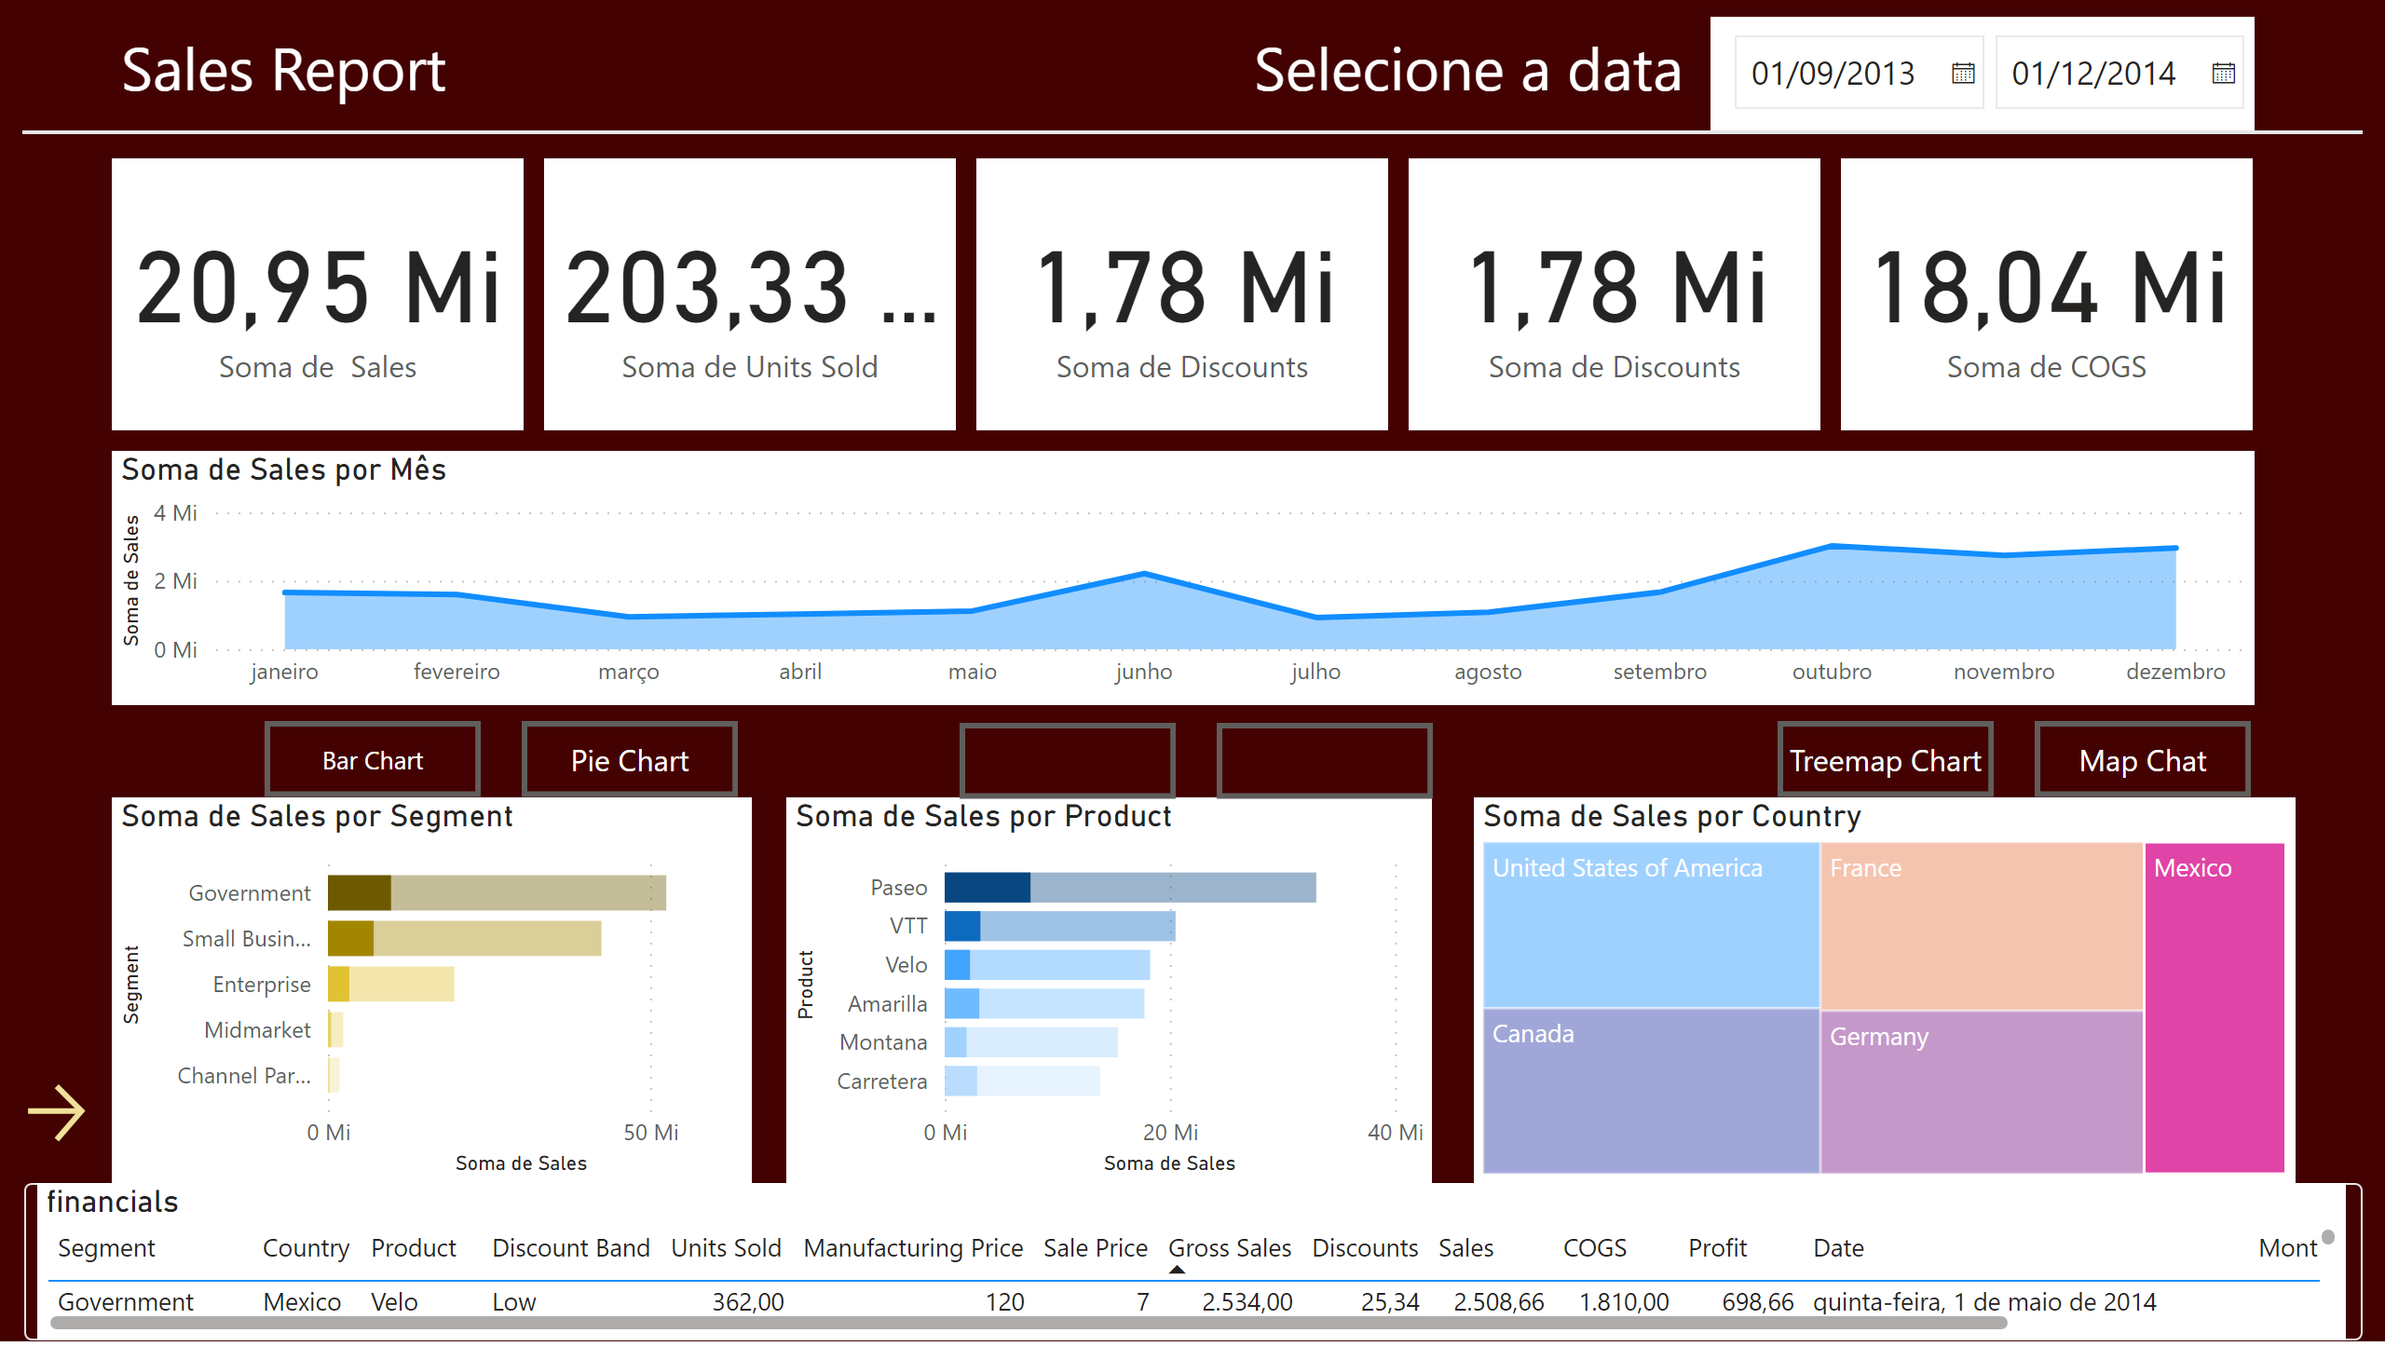
Página 1
Notes:
shape
No alt text provided
shape
No alt text provided
stackedAreaChart
No alt text provided
card
No alt text provided
card
No alt text provided
card
No alt text provided
card
No alt text provided
card
No alt text provided
financials
No alt text provided
clusteredBarChart
No alt text provided
clusteredBarChart
No alt text provided
map
No alt text provided
slicer
No alt text provided
textbox
No alt text provided
textbox
No alt text provided
actionButton
No alt text provided
actionButton
No alt text provided
actionButton
No alt text provided
actionButton
No alt text provided
actionButton
No alt text provided
actionButton
No alt text provided
actionButton
No alt text provided
pieChart
No alt text provided
treemap
No alt text provided

